Slide 1
BIA-654
ANALYSIS FOR GLUCOSE LEVEL OF INDIVIDUALS
Group 2
Amna Shamshad
Kanika Yadav
Asad Sajid Awan
Zhaoyi Xu
Shenglin Wang

Slide 2
Outline
Introduction
Completely Randomized Design
Completely Randomized Analysis of Covariance
Randomized Block Design
Completely Randomized Factorial Design
Randomized Block Factorial Design

Slide 3
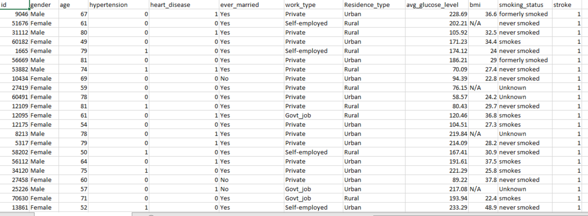
Introduction
Treatment factors :smoking status, working type
Dependent variable: average glucose level
Blocking factor : bmi (less than 25, greater than 25 less than 30, greater than 30)
Covariate: age
We have decided 4 design methods to do our analysis for various variables.

Slide 4
Completely Randomized Design
Treatment Factors - Smoking Status

Slide 5
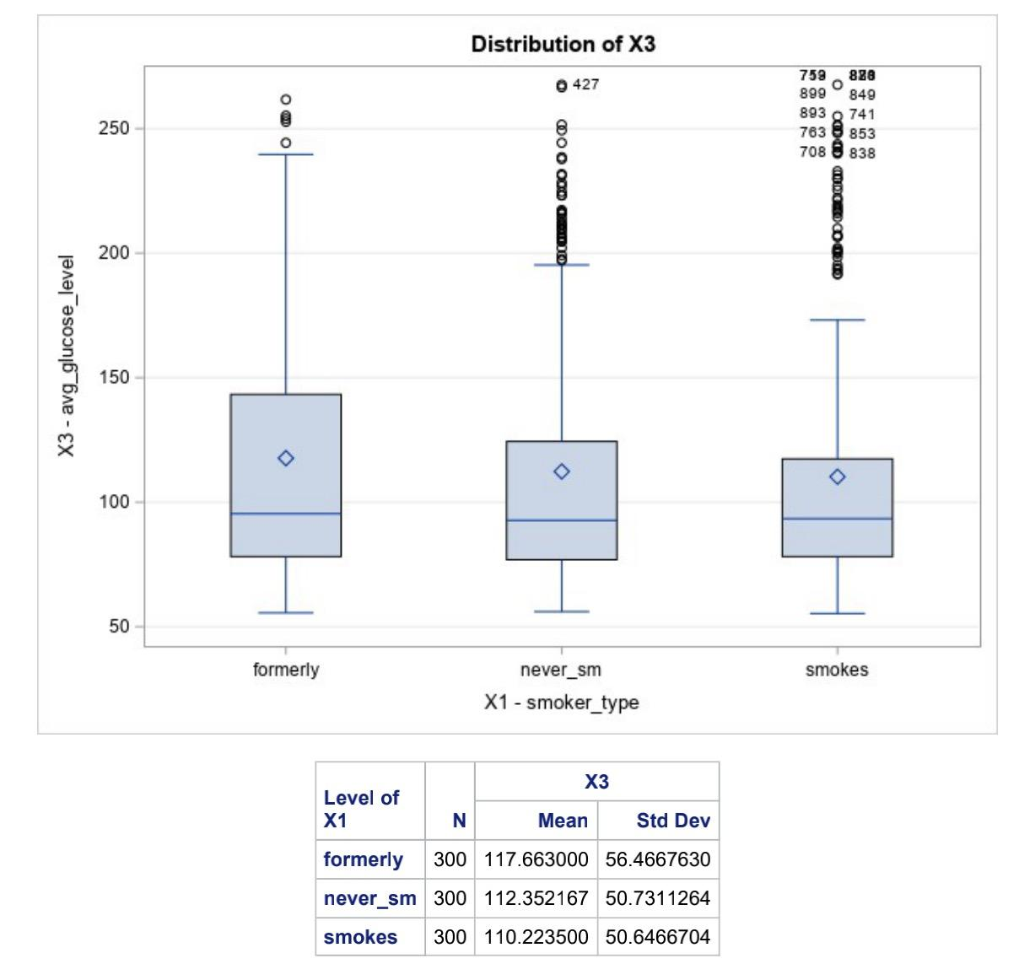
Distribution
From the distribution of average glucose level of all three treatment types when we use smoker type as treatment factor.
We can see they have very similar mean and standard deviation.

Slide 6
EFFECT OF SMOKER TYPE ON GLUCOSE LEVEL
Null And Alternative Hypothesis for All Tests
For the omnibus F test, the null hypothesis is H0: µ1 = µ2 = µ3.
It means the average glucose level of individuals for all three treatment groups are not significantly different from each other i.e smoking status ( former smoker, never smoker, smoker) is equal. The alternate hypothesis is that at least one pair is significantly different
Null Hypothesis: µ1= µ2 , Alternate Hypothesis: µ1 ≠ µ2
Null Hypothesis: µ1= µ3 , Alternate Hypothesis: µ1 ≠ µ3
Null Hypothesis: µ2= µ3 , Alternate Hypothesis: µ2 ≠ µ3

Slide 7
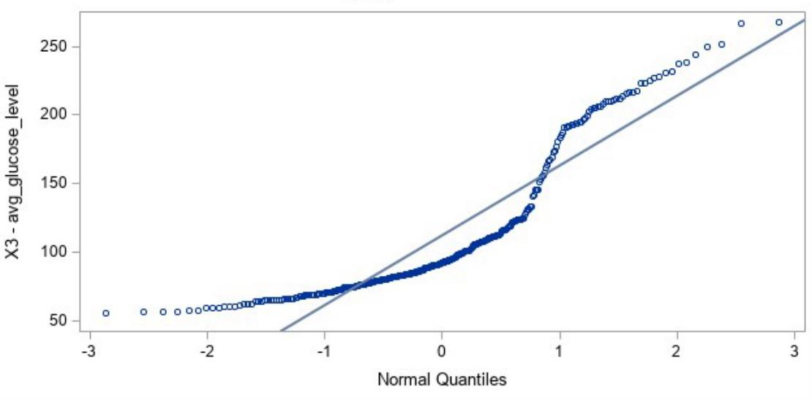
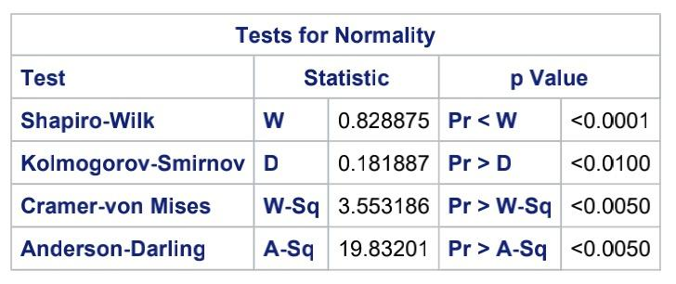
Normality
Since both tests have a p-value < 0.05, they are not normally distributed

Slide 8
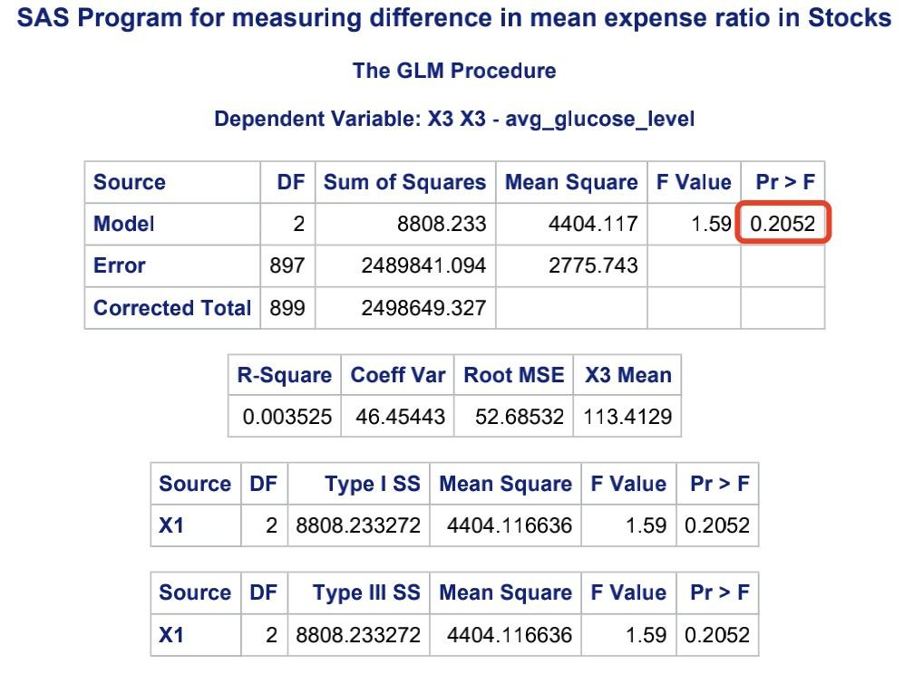
F ANOVA
According to the p-value = 0.2052 > 0.05, we not reject the null hypothesis,
So H0: µ1 = µ2 = µ3
Mainly we have former smoker, never smoker and smoker they are not significantly different in their average glucose level.

Slide 9
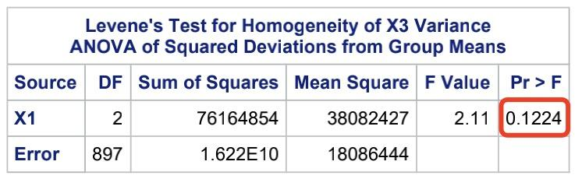
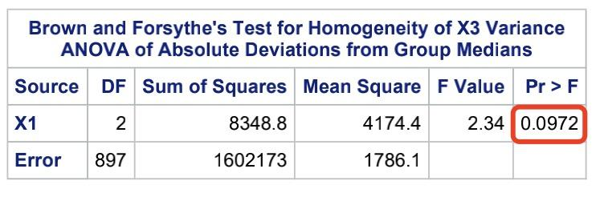
Homogeneous Test
According to the Levene’s Test and and Brown and Forsythe’s Test, we both get p-value > 0.05,
Which means the condition for homogeneity of variances ( homoscedasticity) is met, it’s equal variances across groups in statistical analysis

Slide 10
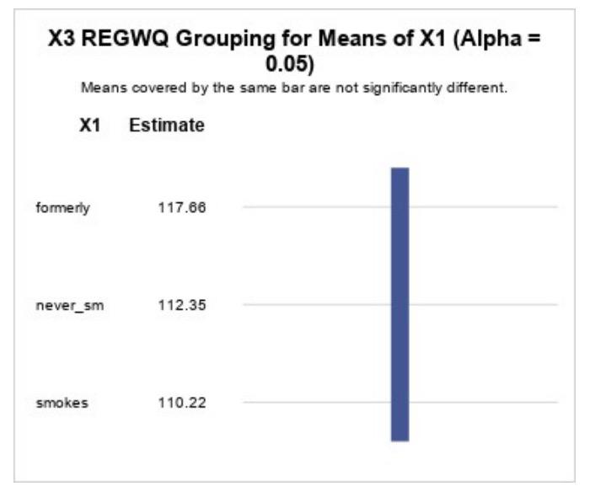
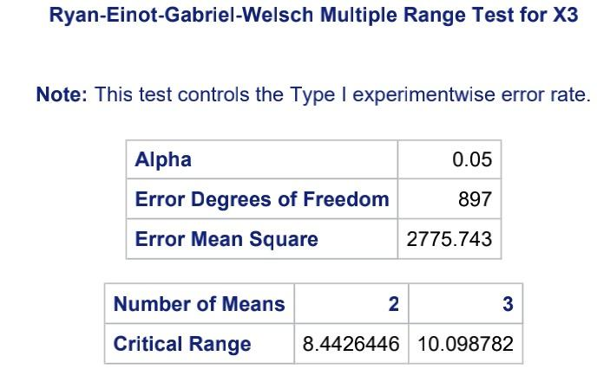
Multiple Comparison Test
According to the result of REGWQ result here,
We can also see all the bars are not significantly different from each other

Slide 11
Completely Randomized Design
Treatment Groups - Work Type

Slide 12
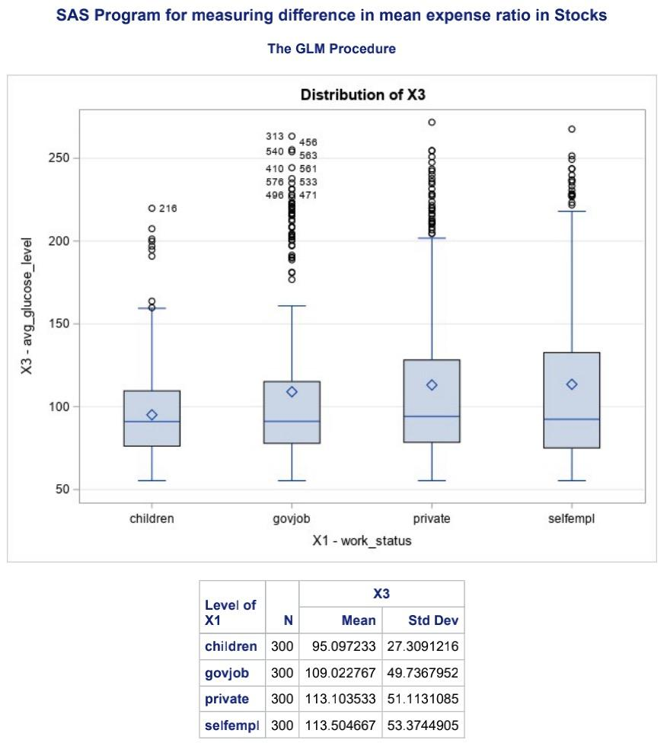
Distribution
From the distribution of average glucose level of all three treatment types when we use work type as treatment factor.
We can see they are not have very similar mean and standard deviation, self employed have higher mean and higher standard deviation in average glucose level than others

Slide 13
EFFECT OF JOB TYPE ON GLUCOSE LEVEL
Null And Alternative Hypothesis for All Tests
For the omnibus F test, the null hypothesis is H0: µ1 = µ2 = µ3 = µ4. It means the mean glucose level of individuals for all 4 treatment groups i.e job types (children, private job, government job, self employed) is equal. The alternate hypothesis is that at least one pair is significantly different.
Null Hypothesis: µ1= µ2 , Alternate Hypothesis: µ1 ≠ µ2
Null Hypothesis: µ1= µ3 , Alternate Hypothesis: µ1 ≠ µ3
Null Hypothesis: µ1= µ4 , Alternate Hypothesis: µ1 ≠ µ4
Null Hypothesis: µ2= µ3 , Alternate Hypothesis: µ2 ≠ µ3
Null Hypothesis: µ2= µ4 , Alternate Hypothesis: µ2 ≠ µ4
Null Hypothesis: µ1= µ3 , Alternate Hypothesis: µ1 ≠ µ3
Null Hypothesis: µ2= µ4 , Alternate Hypothesis: µ2 ≠ µ4

Slide 14
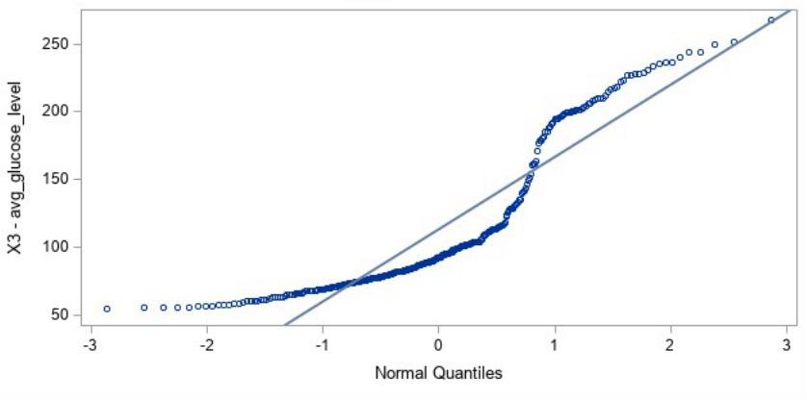
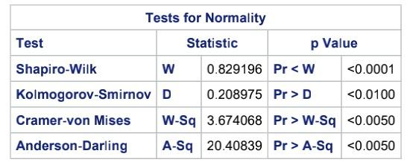
Normality
Since both tests have a p-value < 0.05, they are not normally distributed

Slide 15
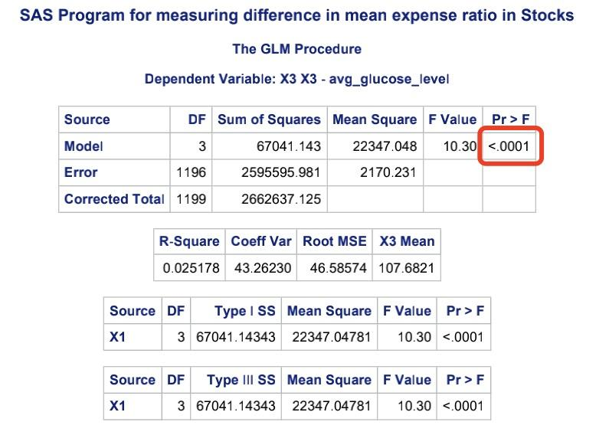
F ANOVA
According to the p-value <0.0001 < 0.05, we should reject the null hypothesis,
So H0: µ1 ≠ µ2 ≠ µ3 ≠ µ4
Mainly we have private job, government job, self employed, they at least one pair is significantly different in their average glucose level.

Slide 16
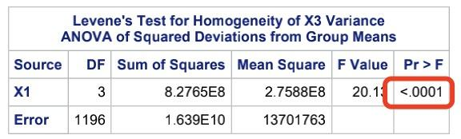
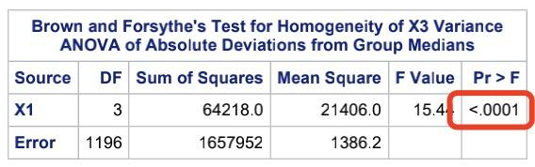
Homogeneous Test
According to the Levene’s Test and and Brown and Forsythe’s Test, we both get p-value < 0.05,
Which means the condition for homogeneity of variances ( homoscedasticity) is not met, it can bias estimates and affect results.

Slide 17
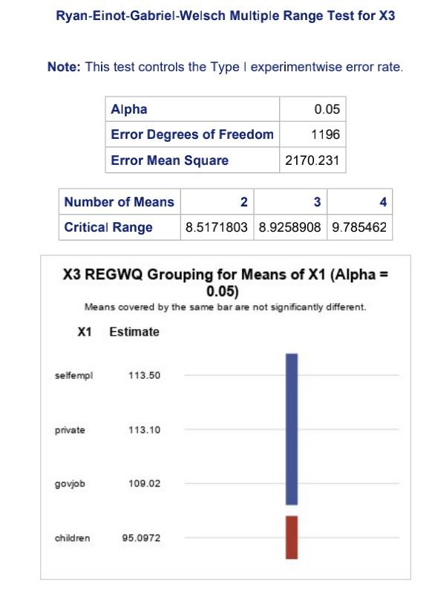
Multiple Comparison Test
According to the result of REGWQ result here,
We can also see children is significantly different from government job and private job

Slide 18
Completely Randomized Analysis of Covariance

Slide 19
EFFECT OF JOB TYPE ON GLUCOSE LEVEL WITH AGE AS COVARIATE
Null And Alternative Hypothesis for All Tests
For the omnibus F test, the null hypothesis is H0: µ1 = µ2 = µ3 = µ4. It means the mean glucose level of individuals for all four treatment groups i.e job types (children,private job, government job, self employed) is equal after controlling for the effects of the covariate variable age. The alternate hypothesis is that at least one pair is significantly different i.e. For each post hoc test, there are 6 possible pairwise tests,
Null Hypothesis: µ1= µ2 , Alternate Hypothesis: µ1 ≠ µ2
Null Hypothesis: µ1= µ3 , Alternate Hypothesis: µ1 ≠ µ3
Null Hypothesis: µ1= µ4 , Alternate Hypothesis: µ1 ≠ µ4
Null Hypothesis: µ2= µ3 , Alternate Hypothesis: µ2 ≠ µ3
Null Hypothesis: µ3= µ4 , Alternate Hypothesis: µ3 ≠ µ4
Null Hypothesis: µ2= µ4 , Alternate Hypothesis: µ2 ≠ µ3

Slide 20
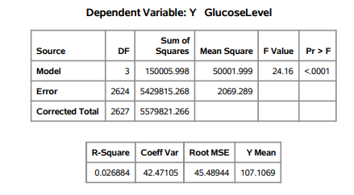
ANOVA Analysis
A total of 2628 observations are read
According to the Type III analysis, the following null hypothesis for treatment A can be rejected: H0: µ.1 = µ.2 = µ.3 = µ.4 because p < 0.05
The model accounts for 2.6% of the variation in the glucose level which is evident by the coefficient of determination, R square value.

Slide 21
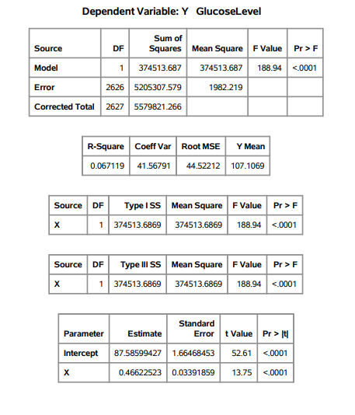
Covariate - Age
The model accounts for a significant (p < .001) amount of the variation in the experiment.
The coefficient of determination, R-Square, indicates that 6.7 percent of the variance in the dependent variable, Y glucose level, is accounted for by the covariate, X i.e age. These results suggest that X (age) is a useful covariate. The equation for predicting Y from X is Y = 87.58+ 0.466X.

Slide 22
Regression Analysis
For treatment group 1 i.e, children, the equation for predicting glucose level Y from covariate X age is
y= 93.01 + 0.226x
For treatment group 2, people who have a government job,, the equation for predicting glucose level Y from covariate X can be derived from the intercept and x estimates shown below.
y= 71.19 + 0.718x
For treatment group 3, people who have a private job, the equation for predicting glucose level Y from covariate X can be derived from the intercept and x estimates shown below.
y= 71.87 + 0.827x
For treatment group 4, people who are self employed, the equation for predicting glucose level Y from covariate X can be derived from the intercept and x estimates shown below
y= 84.52 + 0.478x

Slide 23
Tenability of Assumptions
One of the assumptions of analysis of covariance is homogeneity of the within-groups population regression coefficients: H0: βw1 = βw2 = βw3 = βw4. The four sample regression coefficients shown next are somewhat similar and consistent with the homogeneity assumption:
βw1=0.226
βw2=0.718
βw3=0.827
βw4=0.478

Slide 24
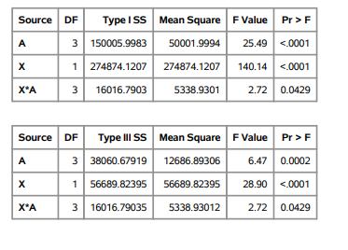
Tenability of Assumptions
This model assumes that the slopes relating glucose levels to age are parallel for all treatment groups i.e job types.
We check this assumption by including the class-by-covariate interaction, JobType*Age, in the model and examining the ANOVA test for the significance of this effect.
It is significant but very close to 0.05, so the equal-slopes assumption can be justified to some extent. .

Slide 25
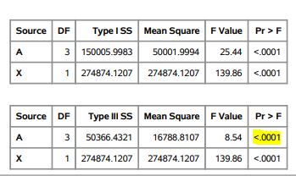
ANCOVA
The F statistic for the Type III analysis of covariance is significant: F = 8.54, p <0.0001.
There is evidence that the job types have a significant effect on the dependent variable glucose level even after accounting for the influence of the covariate age.
It means, if the covariate, individual age, is not taken into account, a researcher will incorrectly conclude that at least one contrast among the methods of teaching language is significant.

Slide 26
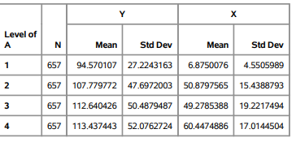
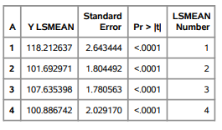
Comparison Of Means before and After Adjusting Covariate
Glucose level for children is lowest and self employed individuals is highest before accounting for the covariate age.
After including the covariate age, self employed individuals have lowest and children have the highest glucose level

Slide 27
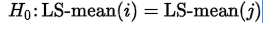
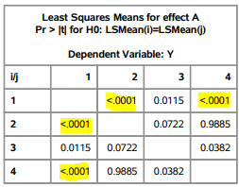
Probability Values for Hypothesis Ho(i)=Ho(j)
All probability values for the hypothesis
are displayed below, where the indexes i and j are numbered treatment levels.
Significance difference between glucose levels of
Individuals with government job and children
Children and self employed individuals

Slide 28
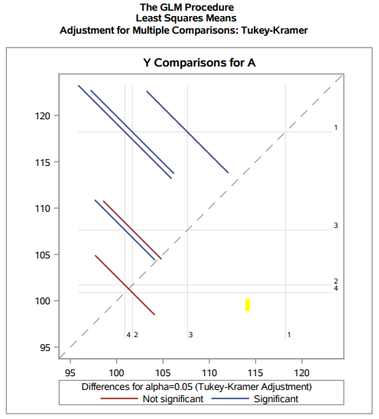
Multiple Comparisons
Difference between treatment groups 2 and 3 not significant
Difference between treatment groups 2 and 4 not significant

Slide 29
EFFECT OF SMOKING TYPE ON GLUCOSE LEVEL WITH AGE AS COVARIATE
Null And Alternate Hypothesis for All Tests
For the omnibus F test, the null hypothesis is H0: µ1 = µ2 = µ3. It means the mean glucose level of individuals for all three treatment groups i.e smoking types(smokes,formerly smokes, never smokes) is equal after controlling for the effects of the covariate variable age. The alternate hypothesis is that at least one pair is significantly different i.e. For each post hoc test, there are 3 possible pairwise tests,
Null Hypothesis: µ1= µ2 , Alternate Hypothesis: µ1 ≠ µ2
Null Hypothesis: µ1= µ3 , Alternate Hypothesis: µ1 ≠ µ3
Null Hypothesis: µ2= µ3 , Alternate Hypothesis: µ2 ≠ µ3

Slide 30
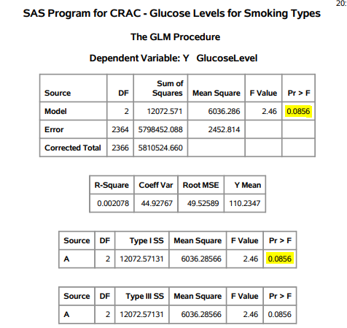
ANOVA Analysis
A total of 2367 observations have been read with three treatment groups.
According to the Type III analysis, the following null hypothesis for treatment A i.e smoking type can not be rejected: H0: µ.1 = µ.2 = µ.3 : F = 6036.286/2452.814 = 2.46, p is 0.0856 means p > 0.05 .
The model accounts for no significant amount of the variation in the experiment which is also evident by the small coefficient of determination, R square value of 0.2%.
It means that the model accounts for 0.2% of variation in the dependent variable which is not significant.

Slide 31
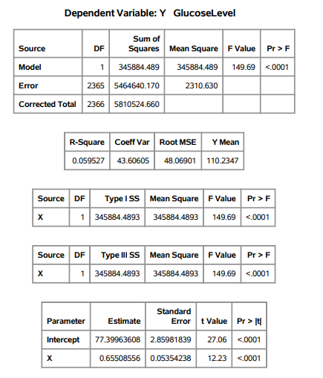
Covariate - Age
The model accounts for a significant (p < .001) amount of the variation in the experiment.
The coefficient of determination, R-Square, indicates that 5.9 percent of the variance in the dependent variable, Y glucose level, is accounted for by the covariate, X i.e age.
These results suggest that X (age) is a useful covariate. The equation for predicting Y from X is
Y = 77.399+ 0.655X.

Slide 32
Regression Analysis
For treatment group 1 i.e, formerly smokers, the equation for predicting glucose level Y from covariate X is
y= 71.79 + 0.75x
For treatment group 2, people who never smoked, the equation for predicting glucose level Y from covariate X can be derived from the intercept and x estimates shown below.
y= 79.98 + 0.63x
For treatment group 3, people who smoke, the equation for predicting glucose level Y from covariate X can be derived from the intercept and x estimates shown below.
y= 80.696 + 0.58x

Slide 33
Tenability of Assumptions
One of the assumptions of analysis of covariance is homogeneity of the within-groups population regression coefficients: H0: βw1 = βw2 = βw3. The three sample regression coefficients shown next are similar and consistent with the homogeneity assumption:
βw1=0.75
βw2=0.63
βw3=0.58

Slide 34
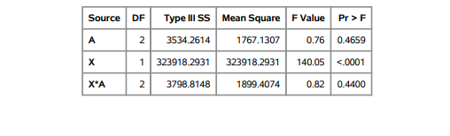
Tenability of Assumptions
This model assumes that the slopes relating glucose levels to age are parallel for all treatment groups i.e smoking types.
We check this assumption by including the class-by-covariate interaction, SmokingType*Age, in the model and examining the ANOVA test for the significance of this effect.
The X × A interaction is not significant: F = 0.82, p = 0.4400 Hence, the homogeneity assumption is tenable.

Slide 35
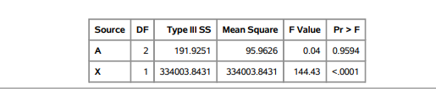
ANCOVA
There is evidence that the smoking types do not have a significant effect on the dependent variable glucose level and becomes more insignificant after accounting for the influence of the covariate age.
However, the covariate does have a significant effect on the dependent variable glucose level
This result indicates that the treatment (smoking type) was not effective in changing the outcome variable i.e glucose level, but the covariate has a significant impact on the glucose level of individuals, and thus, its effect needs to be controlled for in the analysis.

Slide 36
Comparison Of Means before and After Adjusting Covariate
When the means are adjusted for the covariate, the difference among the arithmetic achievement means for the four job types become negligible.
Glucose level for children is lowest and self employed individuals is highest before accounting for the covariate age.
After including the covariate age, self employed individuals have lowest and children have the highest glucose level

Slide 37
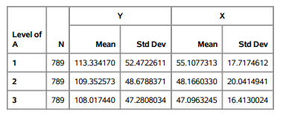
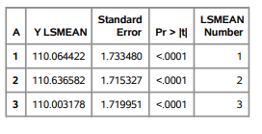
Comparison Of Means before and After Adjusting Covariate
The difference between the means decreases and almost becomes negligible after adjusting for the covariate. The results are consistent with the omnibus F test. Since the means are equal, there is no need to perform multiple comparison tests

Slide 38
Results
For treatment factor work type, work type becomes significant even after accounting for the covariate age, hence age is a useful covariate.
When the means are adjusted for the covariate age, the difference among the mean glucose level slightly increases. The p value before and after accounting for covariate is <0.0001. The results are significant with the significant F test of the omnibus null hypothesis.
There is a significant difference between glucose levels of individuals with government jobs and children (gov job vs children), children and self employed individuals (children vs self employed individuals).
The glucose level for children is lowest and self employed individuals are highest before accounting for the covariate age. After including the covariate age, self employed individuals have lowest and children have the highest glucose level.
The treatment factor smoking type becomes more insignificant after including the covariate age. The difference between the means of three smoking types decreases and almost becomes negligible after adjusting for the covariate. The results are consistent with the omnibus F test as the p value becomes greater after adjusting for covariate .

Slide 39
Randomised Block Design
Blocking Variable - BMI Levels

Slide 40
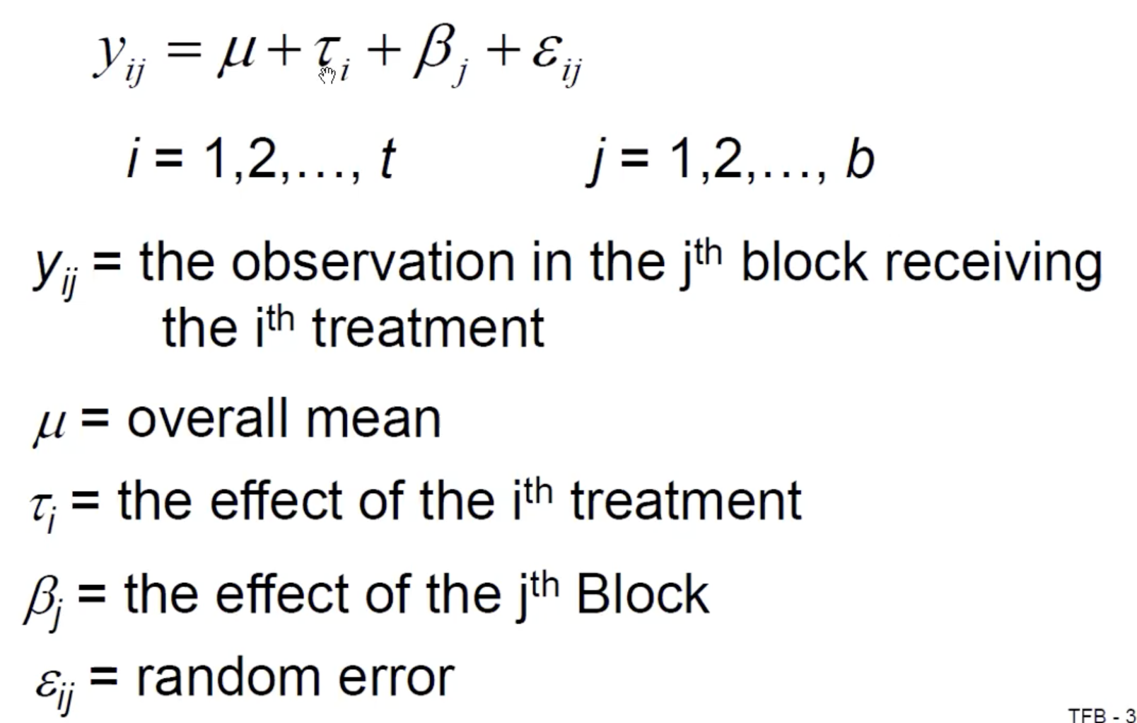
Model for Random Block Design Experiment

Slide 41
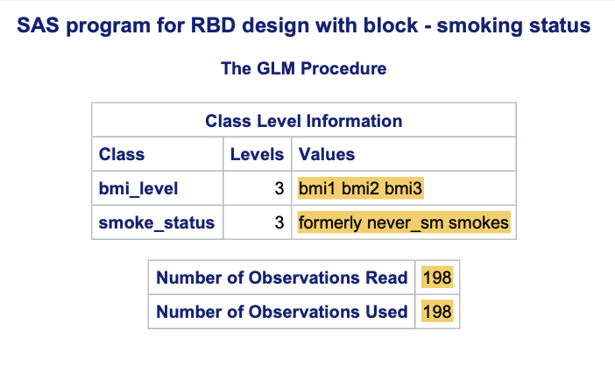
RBD 1 -
Blocking variable - BMI on Glucose with Smoke status
Dependent Factor: Glucose Level
Treatment Factor : Smoke status
Smokes
Formerly Smoked
Never Smoked
Blocking Factor : BMI Level—
bmi1 : range(15 to 30)
bmi2 : range(30 to 45)
bmi3 : range(45 to 60)
Dataset :
Homogeneous experimental units for each of
the Treatment factors and blocking variable

Slide 42
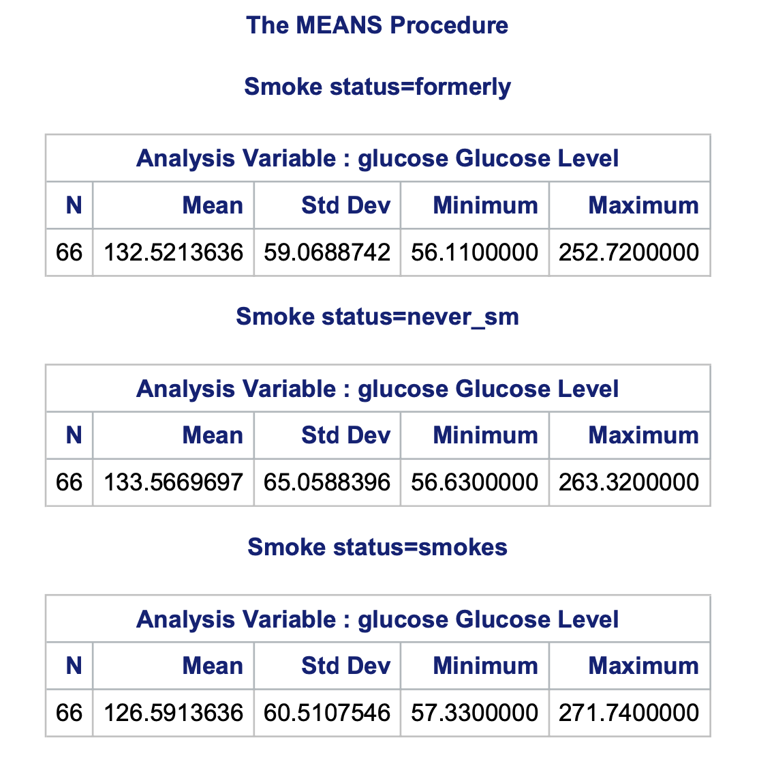
Result : Means Procedure
– For 66 observations std deviation
- 59.06 - 56.63 - 60.51

Slide 43
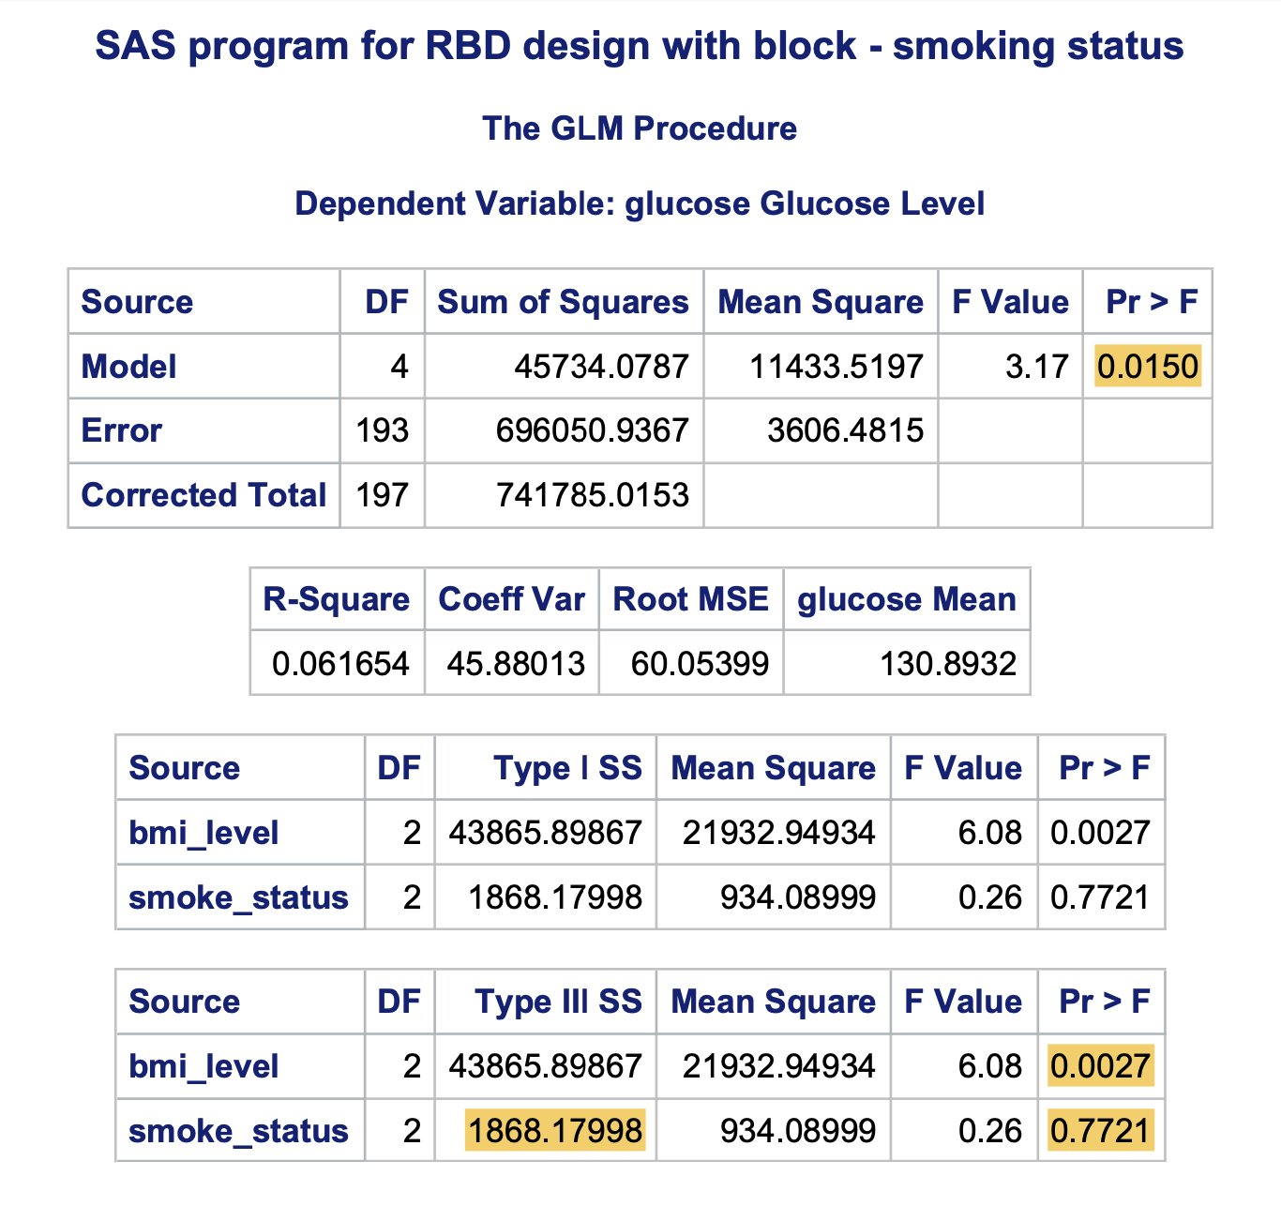
ANOVA Analysis
Initial Model run P value - 0.0150 < 0.05 which is significant hence we can reject the Null hypothesis
Without considering the block levels
Treatment levels Smoking status
On Analysing Treatment factor by Type III SS -
Examine difference between variable - Smoke Status -
H0: µ1 = µ2 = µ3 vs H1: Not all equal for alpha =0.05
Having F-value = 0.26
P-value = 0.7721 > alpha that indicates smoke status has not significant effect and we Do Not Reject the null hypothesis saying Smoke status has no significant impact on the Glucose levels
Also, Examining difference between blocking factor - BMI levels -
H0: µ1 = µ2 = µ3 vs H1: Not all equal for alpha =0.5
Having F-value = 6.08
P-value = 0.0027 < alpha that indicates bmi level means are not significantly different and the bmi level is significant and we do Reject the null hypothesis saying BMI level has significant impact on the Glucose level

Slide 44
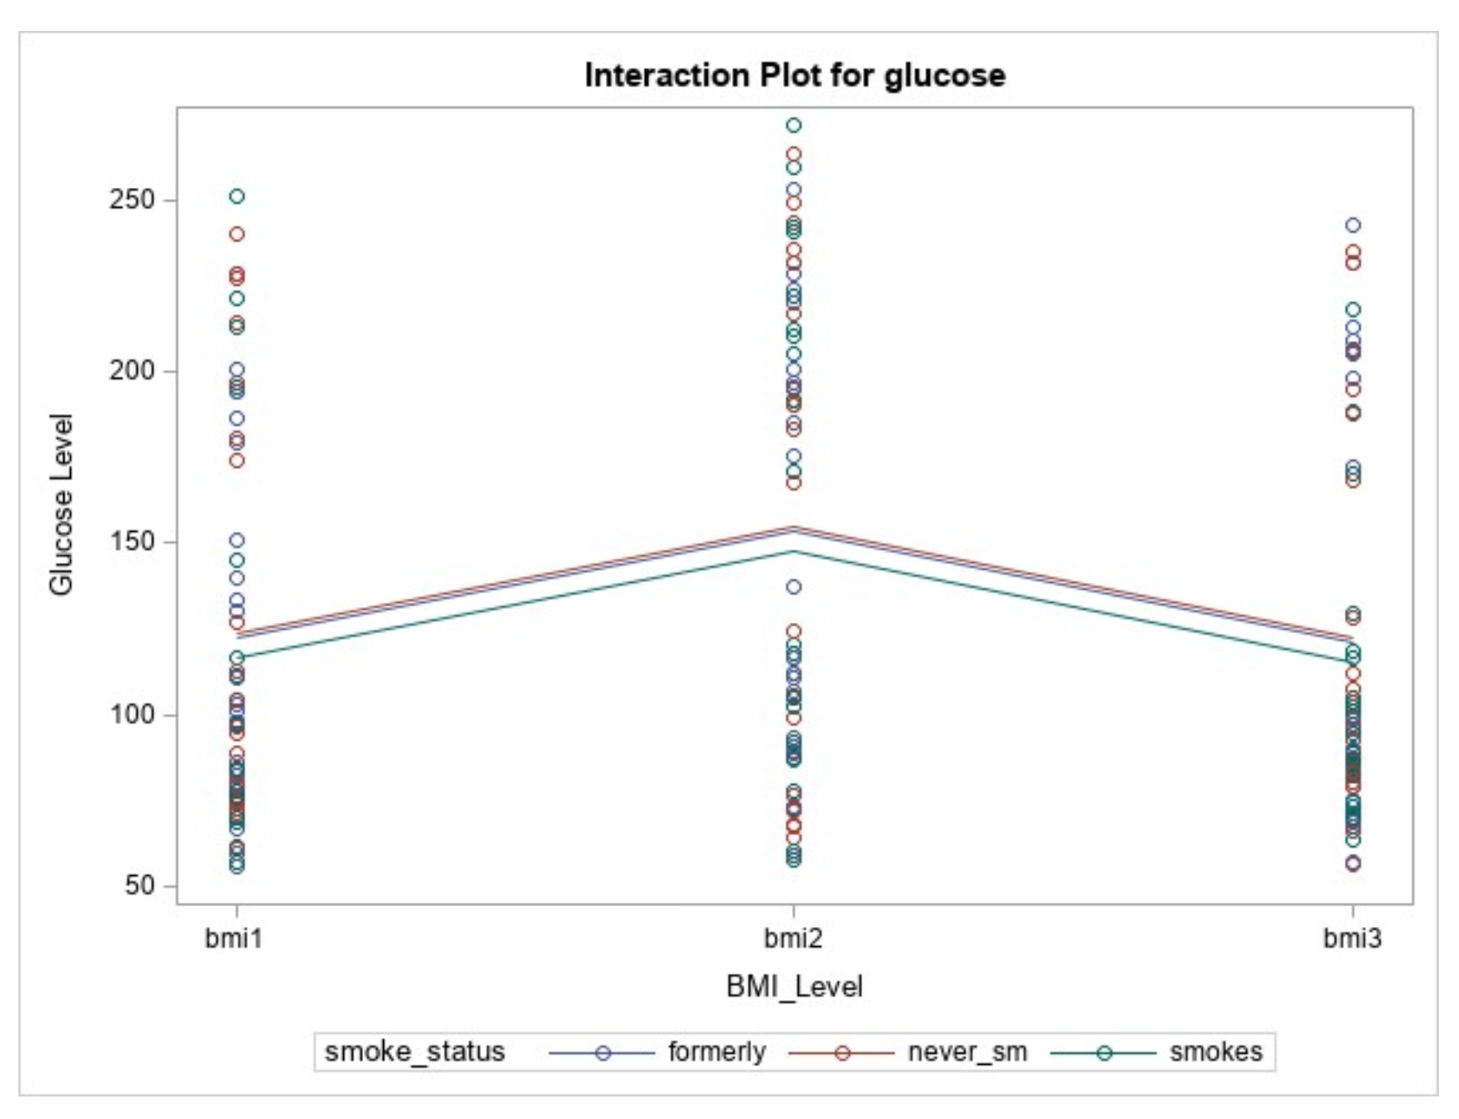
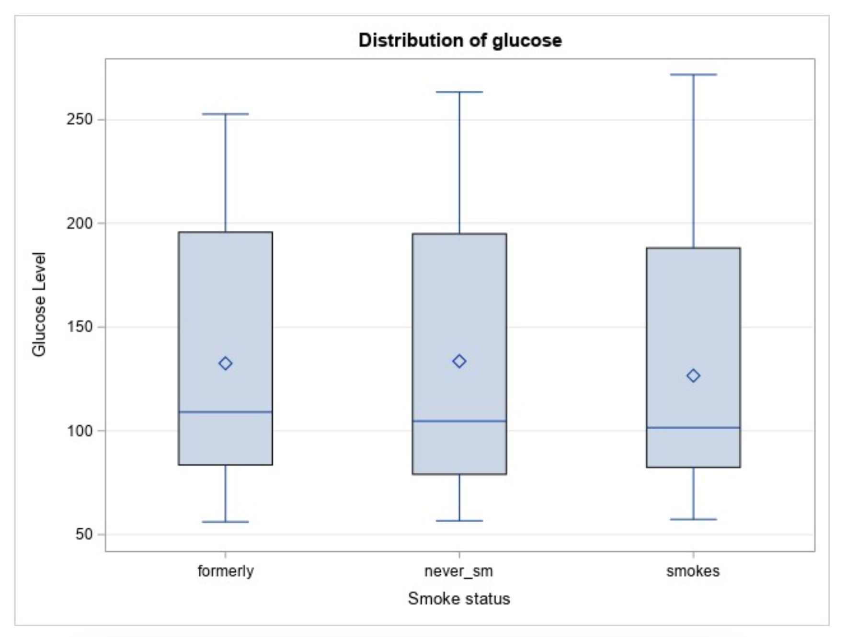
Analysis with charts

Slide 45
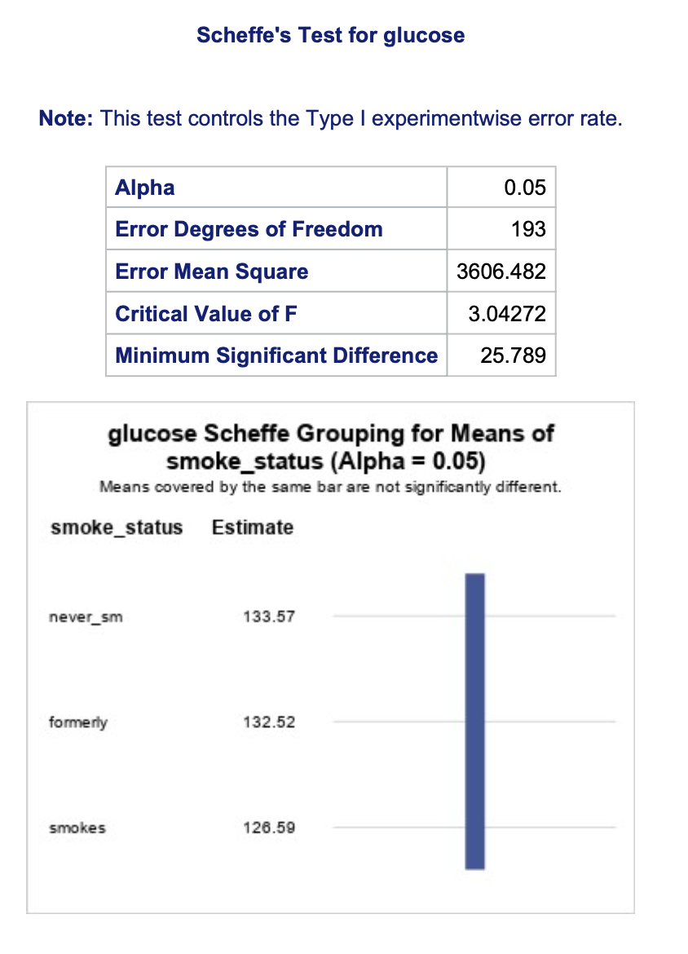
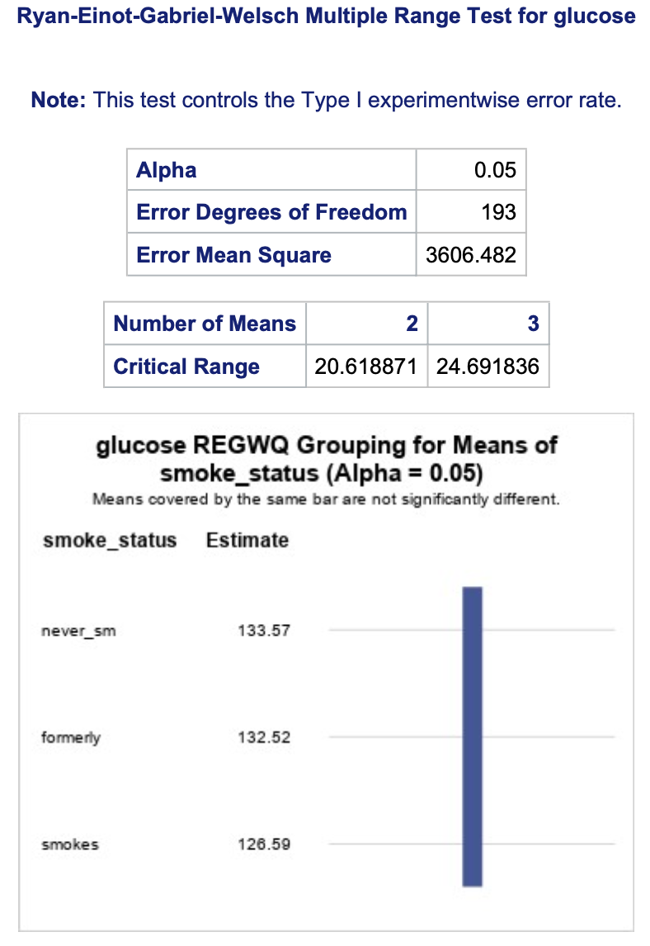
Post Hoc analysis

Slide 46
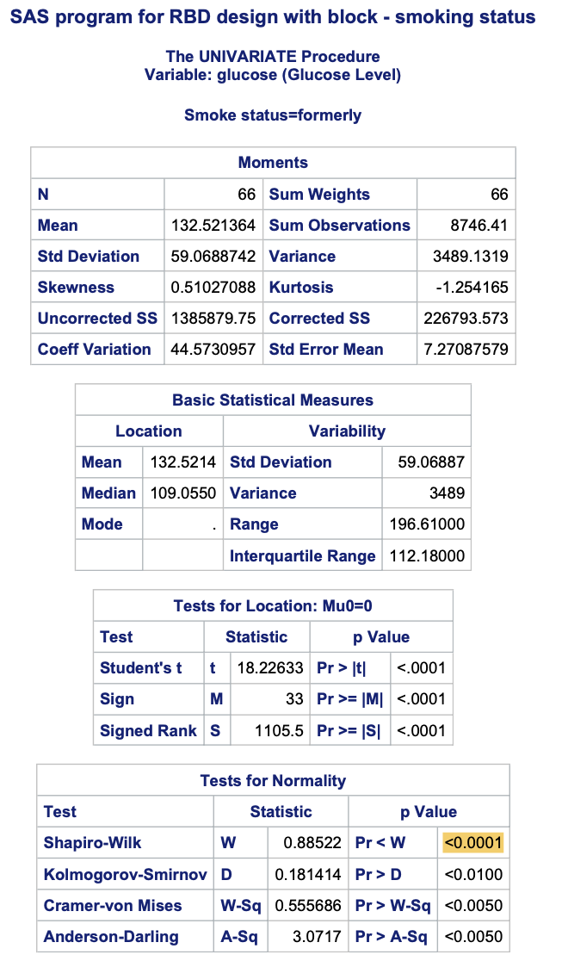
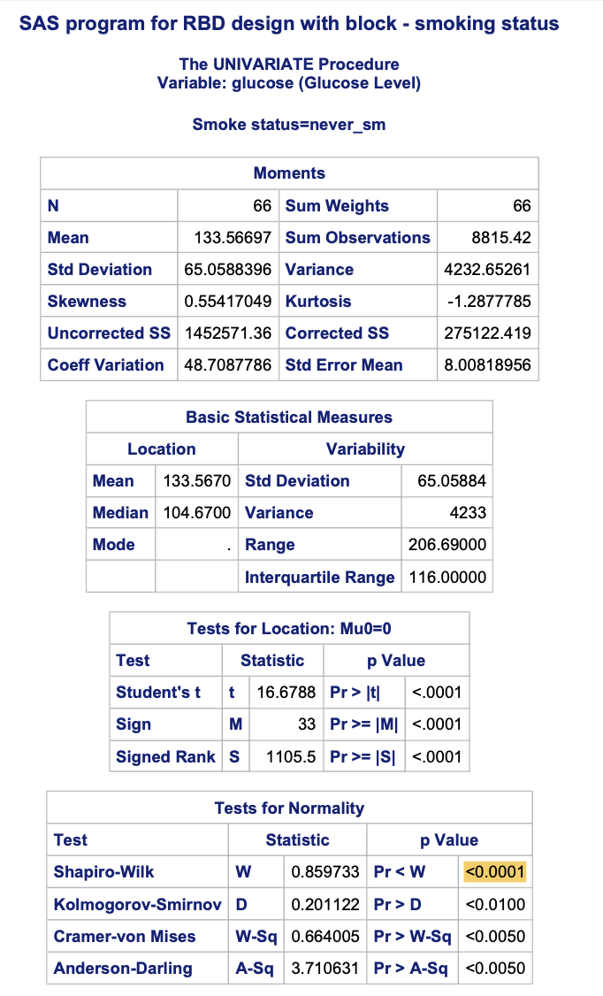
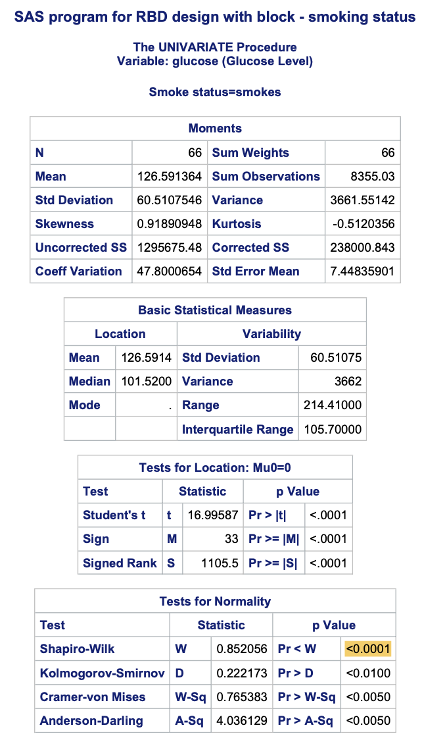
Test for Normality

Slide 47
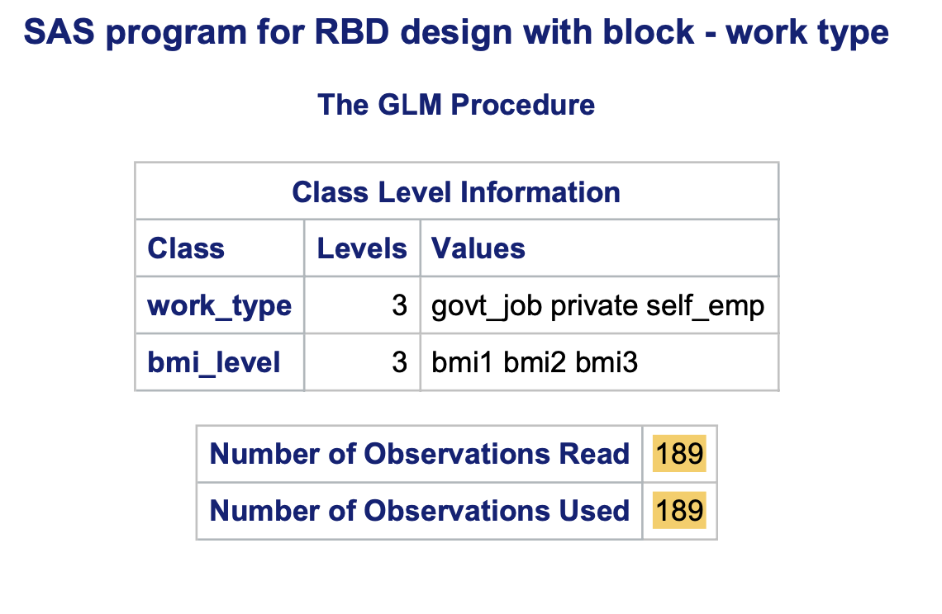
RBD 2 -
Blocking variable - BMI on Glucose with Work Type
Dependent Factor: Glucose Level
Treatment Factor : Work Type
Private
Government Job
Self Employed
Blocking Factor : BMI Level—
bmi1 : range(15 to 30)
bmi2 : range(30 to 45)
bmi3 : range(45 to 60)
Dataset :
Homogeneous experimental units for each of
the Treatment factors and blocking variable

Slide 48
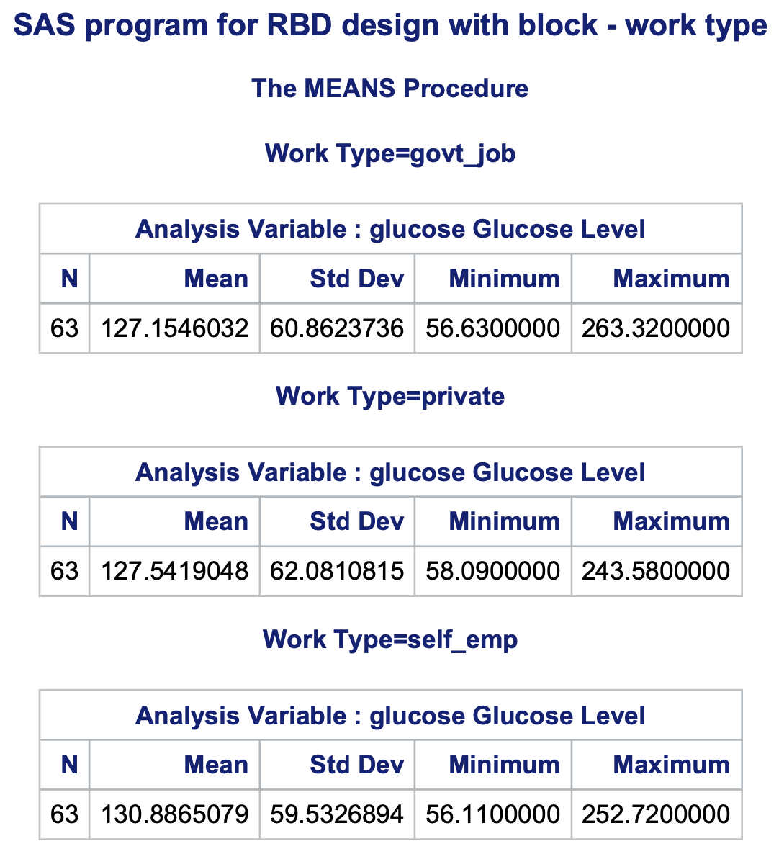
Result : Means Procedure
– for 63 observations in each work type
std deviation of the records
- 56.63 - 58.09 - 56.11 Non- normalised dataset of 189 observations

Slide 49
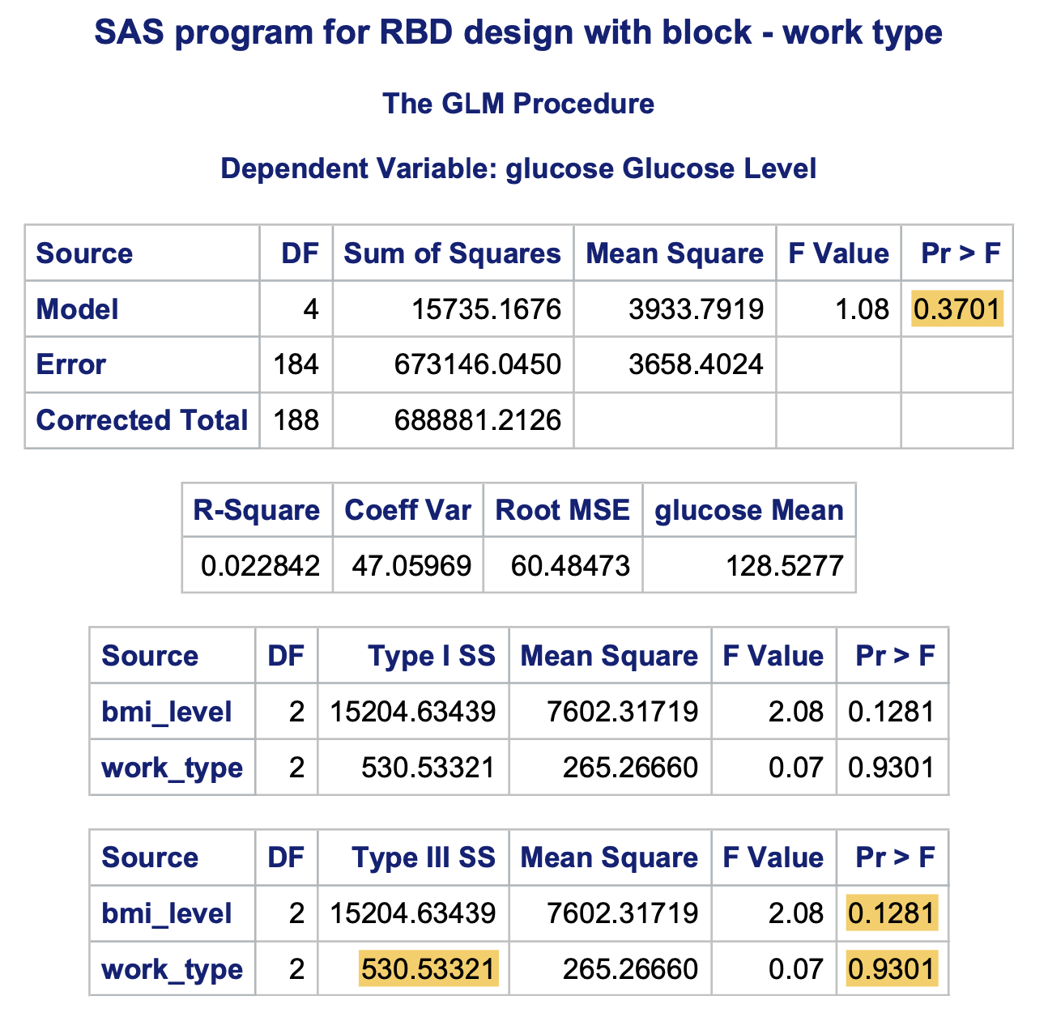
ANOVA Analysis
Initial Model run P value - 0.3701 > 0.05 which is significant
Without considering the block levels
Treatment levels Work Type
On Analysing Treatment factor by Type III SS -
Examine difference between variable - Work Type -
H0: µ1 = µ2 = µ3 vs H1: Not all equal for alpha =0.05
Having F-value = 0.07
P-value = 0.9301 > alpha that indicates work type is not significant and we Do Not Reject the null hypothesis Work Type has no significant impact on the Glucose levels.
Also, Examining difference between blocking factor - BMI levels -
H0: µ1 = µ2 = µ3 vs H1: Not all equal for alpha =0.05
Having F-value = 2.08
P-value = 0.1281 > alpha that indicates bmi level means is significantly different and the bmi level is not significant and we do not Reject the null hypothesis BMI level has significant impact on the Glucose level

Slide 50
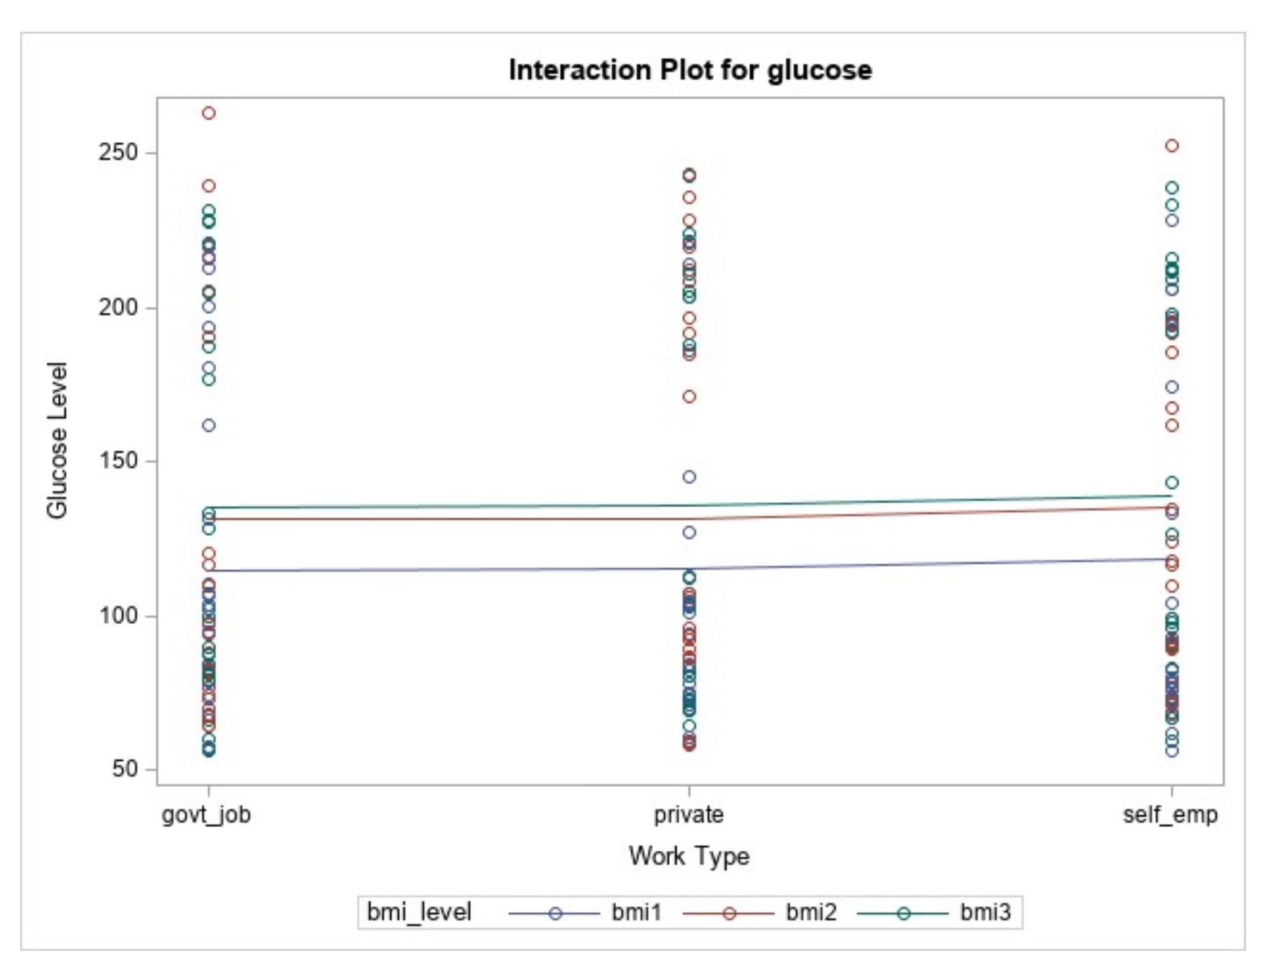
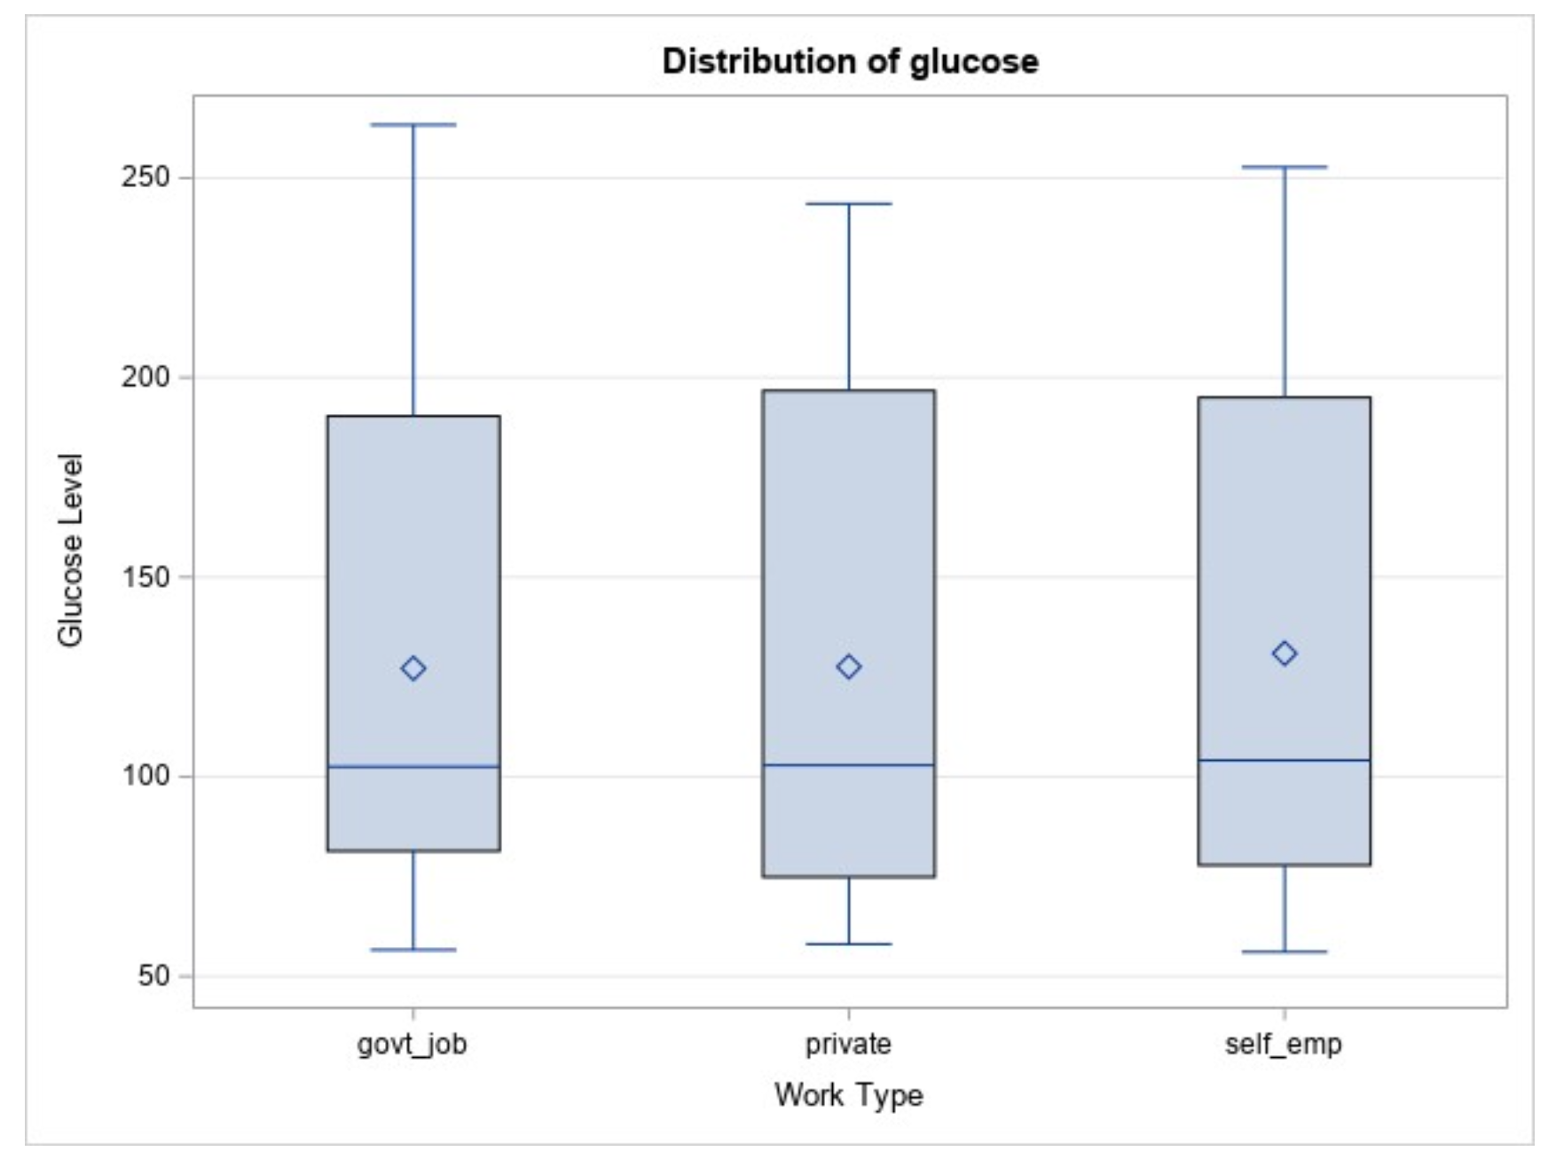
Analysis with charts

Slide 51
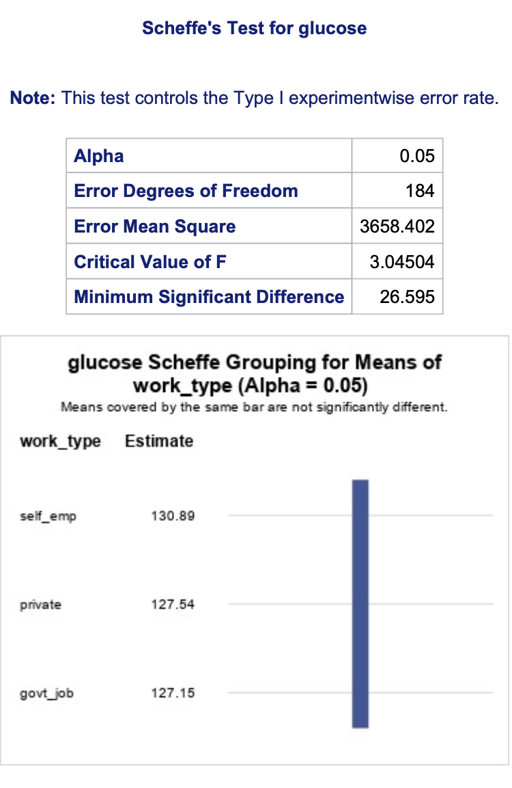
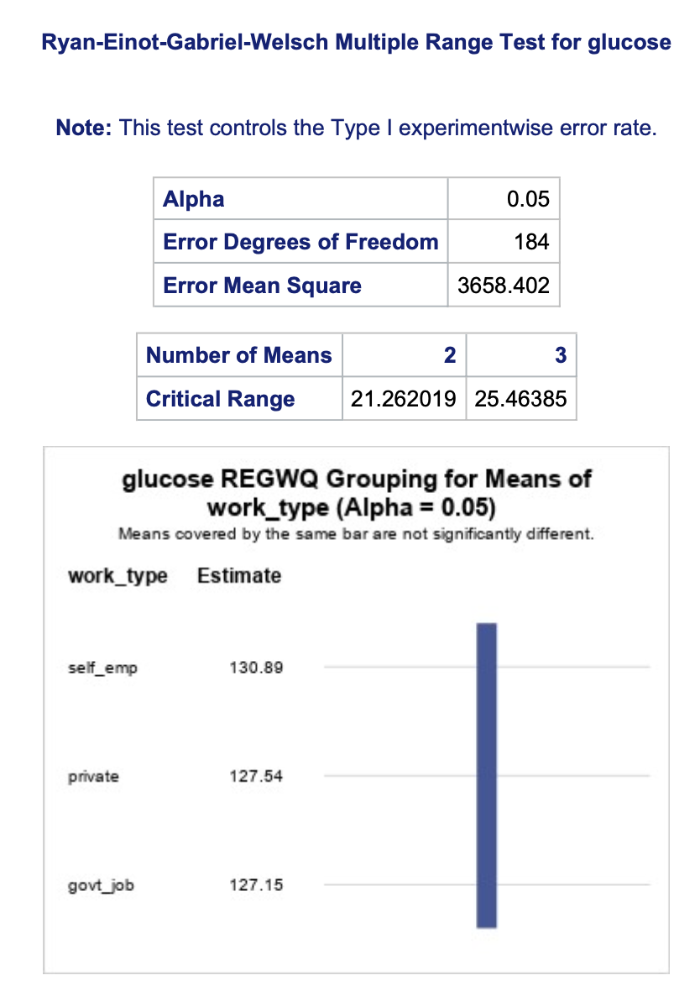
Post Hoc analysis

Slide 52
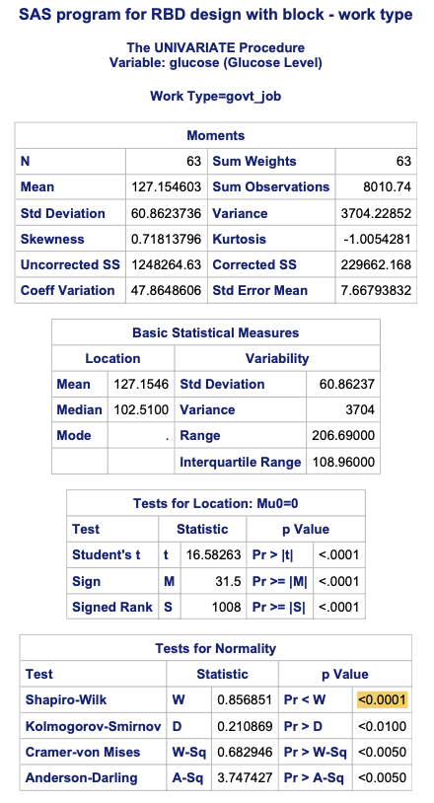


Test for Normality

Slide 53
Results
Results for Randomized block design indicate, BMI Levels are impacting the most in the result of treatments smoke status and work type
Smoking type becomes more insignificant after including the blocking variable and treatment factor work type becomes insignificant after including blocking variable BMI levels. (was significant without including blocking variable)
The individual Type III analysis is also narrowed down to the smoke status or work type as insignificant. We can conclude Glucose levels i.e. dependent variable is heavily impacted by BMI levels.

Slide 54
Completely Randomized Factorial Design
CRF

Slide 55

Introduction of the Problem
Work_Type (Factor X1, categorical variable): Private, Self_employed, Govt_job
Smoking_Status (Factor X2, categorical variable): Smokes, Never_smokes, Formerly_smoked
Avg_Glucose_Level (Response X3, numerical variable)
Testing the main effects and the interaction of two categorical factors
over a nominal variable
Randomized through the testing of each type of Work against each
status of Smoker.

Slide 56
Hypothesis Testing:
Factor X1: Null Hypothesis: There is no effect of work_type on avg_glucose_level:
Private µ = Self-employed µ = Govt_job µ
Factor X1: Alternate Hypothesis: There is an effect of work_type on avg_glucose_level:
Private µ ≠ Self-employed µ ≠ Govt_job µ
Factor X2: Null Hypothesis: There is no effect of smoker_status on avg_glucose_level:
smokes µ = never_smoked µ = formerly_smoked µ
Factor X2: Null Hypothesis: There is an effect of smoker_status on avg_glucose_level:
smokes µ ≠ never_smoked µ ≠ formerly_smoked µ
Factor X1*X2: Null Hypothesis: There is no interaction between work_type and smoker_status to affect avg_glucose_level
Factor X1*X2: Alternate Hypothesis: There is an interaction between work_type and smoker_status to affect avg_glucose_level

Slide 57


Assumptions of ANOVA:
Normality

Slide 58



Assumptions of ANOVA:
Normality: Work Status

Slide 59



Assumptions of ANOVA:
Normality: Work Status

Slide 60

Assumptions of ANOVA:
Homogeneity
No unequal variance: Levene’s
Unequal variance: B and F

Slide 61

Assumptions of ANOVA:
Homogeneity
After taking log
No unequal variance: Levene’s
Barely Unequal variance: B and F

Slide 62

Assumptions of ANOVA:
Homogeneity

Slide 63

Model X1:

Slide 64


Model X1:
T Test: Bonferroni:

Slide 65

Model X2:

Slide 66


Model X1*X2:

Slide 67


Model X1 and X2: Professor’s Recommendation

Slide 68


Groupings:

Slide 69


Box Plots:

Slide 70

Box Plots:

Slide 71
Randomized Block Factorial Design
RBF

Slide 72
Introduction of the Problem
Work_Type (Factor X1, categorical variable): Private, Self_employed, Govt_job
Smoking_Status (Factor X2, categorical variable): Smokes, Never_smokes, Formerly_smoked
Avg_Glucose_Level (Response X3, numerical variable)
Blocking variable (Block, categorical variable):
BMI 1: < 25, BMI 2: > 25 and < 30, BMI 3: > 30
Testing the main effects and the interaction of two categorical factors
over a nominal variable with a block
Randomized through the testing of each type of Work against each
status of Smoker.

Slide 73
Hypothesis Testing: BMI Block
Factor X1: Null Hypothesis: There is no effect of work_type on avg_glucose_level:
Private µ = Self-employed µ = Govt_job µ
Factor X1: Alternate Hypothesis: There is an effect of work_type on avg_glucose_level:
Private µ ≠ Self-employed µ ≠ Govt_job µ
Factor X2: Null Hypothesis: There is no effect of smoker_status on avg_glucose_level:
smokes µ = never_smoked µ = formerly_smoked µ
Factor X2: Null Hypothesis: There is an effect of smoker_status on avg_glucose_level:
smokes µ ≠ never_smoked µ ≠ formerly_smoked µ
Factor X1*X2: Null Hypothesis: There is no interaction between work_type and smoker_status to affect avg_glucose_level
Factor X1*X2: Alternate Hypothesis: There is an interaction between work_type and smoker_status to affect avg_glucose_level

Slide 74

Model: X1*X2

Slide 75

Model: X1*X2

Slide 76

Model: X1*X2 after taking log

Slide 77


Model X1 and X2: Professor’s Recommendation

Slide 78


X1: Work_type

Slide 79


X2: Smoking_status

Slide 80
Appendix A - CRD

Slide 81
Appendix A-CRD

Slide 82

Appendix A-CRD

Slide 83


Appendix A-CRD

Slide 84

Appendix B-CRAC

Slide 85

Appendix B-CRAC

Slide 86

Appendix B-CRAC

Slide 87

Appendix B-CRAC

Slide 88

Appendix B-CRAC

Slide 89

Appendix B-CRAC

Slide 90

Appendix B-CRAC

Slide 91
Appendix C-RBD

Slide 92
Appendix C-RBD

Slide 93
Appendix C-RBD

Slide 94
Appendix C-RBD

Slide 95



Appendix D: CRF

Slide 96



Appendix D: CRF

Slide 97



Appendix D: CRF

Slide 98



Appendix D: CRF

Slide 99



Appendix D: CRF

Slide 100



Appendix D: CRF

Slide 101



Appendix D: CRF

Slide 102



Appendix D: CRF

Slide 103



Appendix D: CRF

Slide 104


Appendix D: CRF

Slide 105

Appendix D: CRF

Slide 106


Appendix D: CRF

Slide 107

Appendix E: RBF

Slide 108


Appendix E: RBF

Slide 109



Appendix E: RBF

